Slide 1
Container Development
Focus Area: Front-end

Slide 2
Training Overview
Group Workshop
Back-end
Front-end
Services
Integration
Content
Services
Advanced
Security
Widget
Development
Widget Extras
Targeting
Publishing
Container
Development
Foundation
Portal Essentials
Portal Technologies
Portal Tools
Portal APIs

Slide 3
Objectives
Understanding containers
Create Your First Container
Notes:
At the end of this module, the trainee should be able to understand what a container is, and be able to develop his own container, add functionality, style it, import and use it in the portal manager.
In order to follow the various exercises in this training, you will need to refer to the training material available here:
https://github.com/Backbase/training-fe-module-03

Slide 4
Understanding Containers
Container Development
Notes:
Before developing a container, trainees need to understand what a container is and remove any confusion with things like templates etc.

Slide 5
What are containers?
Containers
Templates
Layouts
Notes:
There are 3 terms that are somehow related with each other and you need to define what each one is, before going further.
Containers (umbrella term*) are Backbase items, much like widgets. They are used to implement the UI logic of your application. Examples of UI logic include: tabs, accordion, modals, grid/columns. Examples for the containers include: Tab Container, Columns Container.
Layouts is just a label for a specific subset of the containers. Those that are used to layout your webpage. Example of containers that belong to that category are Columns Container, Page Layout Container
Template can refer to 2 things:
The physical file that is used to render a container
The entry in the portal model, pointing to that file
*umbrella term, because usually when people refer to a container they mean both the template and the catalog item. And containers include layouts as well

Slide 6
How do containers work?
Area 0
Area 1
Area 2
Widget
(area=0, order=0)
Widget
(area=1, order=0)
Widget
(area=2, order=0)
Widget
(area=0, order=1)
Container
(area=1, order=1)
Widget
(area=0, order=0)
Widget
(area=0, order=2)
Widget
(area=2, order=1)
Widget
(area=0 order=1)
Notes:
Use the slide to explain 2 concepts:
How the area / order properties work
- Each item in BB has properties like name, title, description in same manner containers do have some extra properties like area and order.
- Here we are viewing example of column container with 3 columns
- area is directly associated with its parent
How containers are nestable, and how widget are only “leaves” in the tree

Slide 7
Container Anatomy
Model
Page Instance
Container Instance
<<extends>>
Portal Catalog
Container Portal
Catalog Item
<<extends>>
Server Catalog
Container Server
Catalog Item
TemplateName
Container
Template
config
Web Tablet Smartphone
Resources
config.xml
template-web.soy
template-web.soy
template-web.soy
Javascript
CSS
Notes:
Template is abstract object in the portal model pointing its resources (template files). We use Google Closure .soy files .
Google closure template (soy file). This will be what is rendered for the container. This is your markup
config.xml We need a way to define resource that are included with the container (ie. scripts + styles). Since we can’t put <link> and <script> in the soy template, we have config.xml to define our resources. You can rename it, but we use “config” by convention
Java script to handle the event
CSS for styling of container.

Slide 8
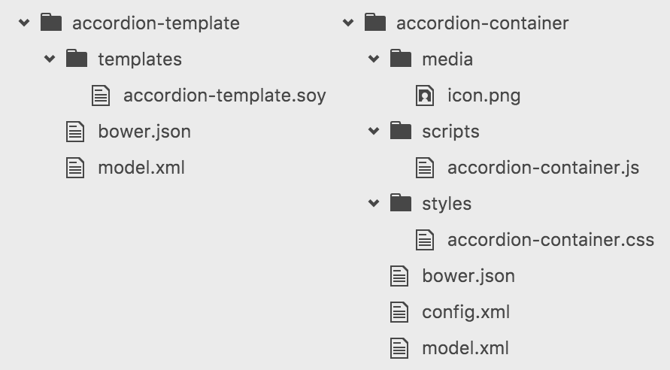
Container Structure
Google Closure (soy) as content
JS for functionality
CSS for styling
XML for configuration and definition of resources
Notes:
Google Closure (soy) as content – it is a markup language.
JS for functionality
CSS for styling
XML for configuration and definition of resources

Slide 9
Container Definition
Container Development

Slide 10
Container Definition
soy Template
config.xml
Notes:
To define a container you need 2 things:
Google closure template (soy file). This will be what is rendered for the container. This is your markup
config.xml We need a way to define resource that are included with the container (ie. scripts + styles). Since we can’t put <link> and <script> in the soy template, we have config.xml to define our resources. You can rename it, but we use “config” by convention

Slide 11
Container Definition – SOY Template
{namespace com_backbase_training}
/**
* Accordion Container
* @param item Item in context
*/
{template .AccordionTemplate}
<div data-pid="{$item.name}" class="bp-container bp-ui-dragRoot">
<div class="accordion--area bp-area">
{foreach $child in $item.children}
{if parseInt($child.preferences.area.value) == 0}
{include($child) |noAutoescape}
{/if}
{/foreach}
</div>
</div>
{/template}
Notes:
Make sure that everyone knows what the accordion UI element is
Things to explain here:
{namespace com.backbase.training} the dots and dashes get replaced by underscores by the bb cli.
{template .AccordionTemplate} -> it’s the name of the template you define in the portal model
.bp-container -> needed for the portal to render this properly
. bp-ui-dragRoot -> to allow dragging of the container itself
data-pid="{$item.name}" -> again needed for the portal to render this properly (no need to say more in the scope of this training)
.accordion--area -> --area suffix is needed, but you can attach it to any class… eg. anything--area
Explain what happens in the loop a bit
CAREFULL
google closure compiler is grumpy when it comes to whitespaces. An extra space in the beginning of some lines can break rendering. Explain to trainees (explain that is the compiler restriction, not the portal)

Slide 12
Container Definition – Resources
<?xml version="1.0" encoding="UTF-8"?>
<w3c:widget xmlns:w3c="http://www.w3.org/TR/widgets"
xmlns:bb="http://www.backbase.com/ns/widgets"
xmlns="http://www.w3.org/1999/xhtml">
<bb:resources>
...
</bb:resources>
</w3c:widget>
Notes:
in bb:resources you can have <script> and <link> tags, with the standard html syntax
paths are relative to config.xml

Slide 13
Exercise: Create Your First Container
Scaffold an “Accordion” container template structure using the “bb generate” command of bb-cli (generate an “container-template”)
Import the template in the Enterprise Catalog
Scaffold an “Accordion” container structure using the “bb generate” command of bb-cli (generate an “container”)
Import your container in the Enterprise Catalog and enable it for your portal
Notes:
https://my.backbase.com/docs/product-documentation/documentation//portal/5.6.2/containers_containertemplate.html
https://my.backbase.com/docs/product-documentation/documentation//portal/5.6.2/containers_container.html
https://my.backbase.com/docs/product-documentation/documentation//portal/5.6.2/containers_import.html
Template
bb generate template
Template title – Accordion Template
Template name – accordionTemplate
Bundle name – Training Collection
Bundle prefix - tc
cd accordion-template
bb import-item
Container
bb generate container
Container title – Accordion Container
Render type – ssr
Container name – accordion-container
Template name – accordionTemplate
Section tag– Training
Regular tags – Training
Bundle name - Training Collection
Bundle prefix – tc
cd accordion-container
bb import-item

Slide 14
Container Functionality
Container Development

Slide 15
Container Functionality
Base container
object
Client side
template
Custom handlers
Notes:
There is a base container object in the portal client, and all containers are created by extending it.
We need js for 2 reasons:
to add functionality, just like in the case of a window. eg. to make the accordion areas slide up and down
to allow drag and drop and interaction within the portal manager. Eg. to allow dropping of items in an area. That’s why we need to extend the base container object. https://my.backbase.com/docs/product-documentation/documentation//portal/5.6.2/events_containerevents.html#/list
We also have the option of declaring a specific client side template (don’t focus on this too much)
(smiley face slide)

Slide 16
Container Functionality
(function () {
var Container = b$.bdom
.getNamespace('http://backbase.com/2013/portalView')
.getClass('container');
Container.extend(function (bdomDocument, node) {
Container.apply(this, arguments);
this.isPossibleDragTarget = true;
}, {
localName: 'AccordionTemplate',
// the same as the viewNamespace property in the import XML for the container
namespaceURI: 'com.backbase.training'
}, {
handlers: {
DOMReady: function () {
// triggers when the container is rendered
}
}
});
})();
Notes:
Things to focus on:
getting the container class from the namespace (same for every container)
Extending the container class (same for every container again)
localName (needs to be the same as the template name) and namespaceURI
Container.extend gets 3 params:
function that does the mixin
object with properties to override (eg. localName)
object with extra functionality (eg. handlers)
Mention that a lot of the practices are the same like the wigdet… eg. how to select elements within the context of the instance

Slide 17
Container Functionality
<?xml version="1.0" encoding="UTF-8"?>
<w3c:widget xmlns:w3c="http://www.w3.org/TR/widgets"
xmlns:bb="http://www.backbase.com/ns/widgets"
xmlns="http://www.w3.org/1999/xhtml">
<bb:resources>
<script type="text/javascript" src="js/accordion.js"></script>
</bb:resources>
</w3c:widget>
Notes:
Always remember that the paths are relative to config.xml

Slide 18
Exercise: Create Your “Accordion” UI
Implement the Accordion UI:
Increase your areas to 3 (all hidden by default, use Bootstrap for that)
Make sure there is a title for each area (configurable via a preference)
When clicking the title, the specific area should become visible and the others should be hidden
Notes:
This should be quite easy if they finished the previous with success (hardest part with containers is getting started)
This doesn’t have much to do with BB Portal, but it will be a good exercise to finish it.
Careful not to write any styles at this point.
Just use the Twitter Bootstrap “hidden” class.
Make sure you follow the general practices from the cookbook
TODO - Feedback from Trainees
Ppl need to have more information about what to do in here with.

Slide 19
Container Styling
Container Development

Slide 20
Container Styling
Backbase
Themes
VS
Container
Styles
Notes:
It’s the same slide as the widget training, same things apply for the containers. Same notes follow:
Before going into styling, you need to explain a couple of things:
Backbase Themes
What the server is, and how our themes are based on Bootstrap/LESS, but they can be built with any other preprocessor or plain CSS
2) What to put in theme, and what in the widget itself
Talk about OOCSS, reusable components.
As a rule of the thumb, any of the following is theme related:
typography (font styles on headings and paragraphs, related colors)
form elements (any styles on inputs, dropdowns, checkboxes etc)
links and buttons
navigation elements, breadcrumbs
grid system
specific helper classes (eg. clearfix, hidden etc)

Slide 21
Container Functionality
<?xml version="1.0" encoding="UTF-8"?>
<w3c:widget xmlns:w3c="http://www.w3.org/TR/widgets"
xmlns:bb="http://www.backbase.com/ns/widgets"
xmlns="http://www.w3.org/1999/xhtml">
<bb:resources>
<link type="text/css" rel="stylesheet" href="css/accordion.css"/>
<script type="text/javascript" src="js/accordion.js"></script>
</bb:resources>
</w3c:widget>

Slide 22
Exercise: Style Your Container
Using Twitter Bootstrap (getbootstrap.com), use the “Panels” styles for your areas and your titles.
Optional 1
Using a combination of Twitter Bootstrap, custom styles and changes in your template, make the Accordion horizontal
Optional 2
Change your Accordion container to a Tab container (to save time, don’t change the names of the files and the items in the portal model)
Notes:
For the TAB Container
https://my.backbase.com/docs/how-to-guides/writing-your-first-container-with-closure#/list
https://my.backbase.com/docs/how-to-guides/article//writing-your-first-container-with-closure#/list
Optional 2 ???

Slide 23
Client-Side Rendering
Container Development

Slide 24
Client-Side Rendering
<?xml version="1.0" encoding="UTF-8"?>
<w3c:widget xmlns:w3c="http://www.w3.org/TR/widgets"
xmlns:bb="http://www.backbase.com/ns/widgets"
xmlns="http://www.w3.org/1999/xhtml">
<bb:resources>
<link type="text/css" rel="stylesheet" href="css/accordion.css"/>
<script type="text/javascript" src="js/accordion.js"></script>
<script type="text/javascript"
src="$(contextRoot)/templates/AccordionTemplate/template.js"></script>
</bb:resources>
</w3c:widget>

Slide 25
Client-Side Rendering
(function () {
var Container = b$.bdom
.getNamespace('http://backbase.com/2013/portalView')
.getClass('container');
Container.extend(function (bdomDocument, node) {
Container.apply(this, arguments);
this.isPossibleDragTarget = true;
}, {
localName: 'AccordionTemplate',
// the same as the viewNamespace property in the import XML for the container
namespaceURI: 'com.backbase.training'
}, {
template: function(json) {
var data = {item: json.model.originalItem};
var sTemplate = com_backbase_training.AccordionTemplate(data);
return sTemplate;
},
handlers: {
DOMReady: function () {
// triggers when the container is rendered
}
}
});
})();

Slide 26
Exercise: Client-Side Rendering
Make the container client-side rendered.
(Change the value of the csr property to true.)

